Slide 1


ABOUT PRALOTECH COMPANY
Presentation by:
Divyaprada G

Slide 2
Company Profile…..
o1. Overview of the Organization.
o2. Vision and Mission of the Organization.
o3. Organization Structure.
o4. Roles and Responsibilities of Personnel in the Organization.
o5. Products and Market performance.

Slide 3

Overview of the Organization
With the active participation of its multi-disciplinary Assignment Execution Team, Pralotech Solutions has emerged as a leader in the ITES in India and has established itself in the field of software development, data processing, data conversion, digital printing, Digitization, System integration, smart card personalization, IT facility management and other IT enabled services.
Pralotech Solutions LLP, incorporated in end of 2018, is a professionally managed, rapidly growing, multifaceted Information technology company.
The company is actively involved in developing automation and e-Governance solutions for Transport, Social Security, Citizen Identity, Education, Public Distribution System, Retail Management and a host of other application areas.

Slide 4
Pralotech Solutions is a leading System integrator in India providing complete turnkey solutions on BOO & BOOT basis including facility management services, Smart Cards applications, Document Management System (DMS), Work Flow Management and Manpower Deployment.
Pralotech Solutions has successfully completed many e-governance projects for the various departments of Govt of Karnataka and has won accolades for its superior service delivery, timely execution of projects and the quality of the deliverables.
PRALOTECH SOLUTIONS is being trusted by many clients who are looking for reliable and quality services for their business.
PRALOTECH SOLUTIONS is currently operating and managing in Bangalore and giving services to e-commerce business services.
Pralotech Solutions adopted project team and dedicated organization structure. In project based organization.

Slide 5
Vision and Mission of the Organization
Vision:
Vision Statement: “To be the pioneer in e-commerce solutions by building and implementing robust and future proof systems which are efficient, transparent and accountable.”
Mission:
“To enable its customers to achieve total e-commerce through innovative solutions using the cutting edge technologies and to provide world class IT and ITES services at affordable costs to the customers with fast turnaround time and to continually improve the service delivery at the client service centre’s managed by us.”
Over the next few years our goal is to harness our talents and skills by permeating our company further with process-centered management. In this way, once a customer's project enters our quality oriented process, it will exit as a quality product.

Slide 6
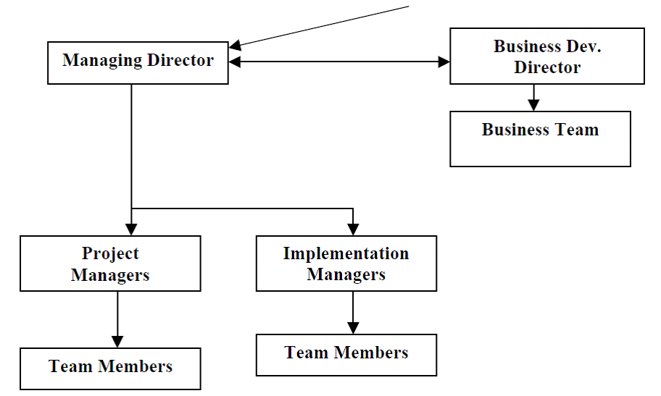
Organization Structure
ADVISORY AND GOVERNING BOARD

Slide 7
Roles and Responsibilities of Personnel in the Organization
Responsibilities of the Internship Student During the internship, the student is responsible for the following:
1. Discuss progress and engage in discussion of topics relevant to the operation and philosophical perspective of the office and functional area in general.
2. Carry out established activities and any additional responsibilities which are mutually agreed upon by the student and site supervisor.
3. Fulfill agreed upon time commitments.
4. Conduct oneself in a responsible and professional manner.
5. Raise concerns with the site supervisor and seminar instructor if the objectives for the internship are not being met or if the supervision being received is inadequate.

Slide 8
Product and Market Performance
PRODUCT : PRALOTECH SOLUTIONS provides flexible investment solutions, such as leasing, financing, utility programs and asset management services, for customers to enable the creation of unique technology deployment models and acquisition of complete IT solutions, including hardware, software and services from PRALOTECH SOLUTIONS and others.
Providing flexible services and capabilities that support the entire IT lifecycle, partners with customers globally to help build investment strategies that enhance their business agility and support their business transformation.
PRALOTECH SOLUTIONS offers a wide selection of investment solution capabilities for large enterprise customers and channel partners, along with an array of financial options to SMBs, educational and governmental entities.

Slide 9
MARKET PERFORMANCE : Since its inceptions and with initial small steps, Pralotech Solutions is now progressing by leaps and bounds.
It has grown from a small venture to a medium scale enterprise with a strong 80+ workforce, our rate of more than 100%.
The company is executing some of the prestigious projects and has earned a very respectable name in the Indian IT and e-commerce industry.

Slide 10


THE END
Thank You

